Slide 1
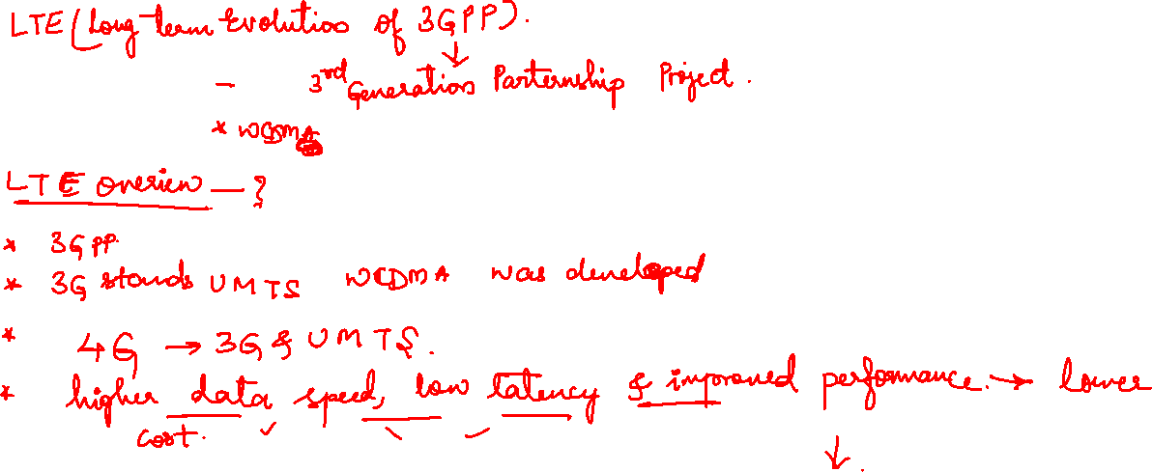

Slide 2
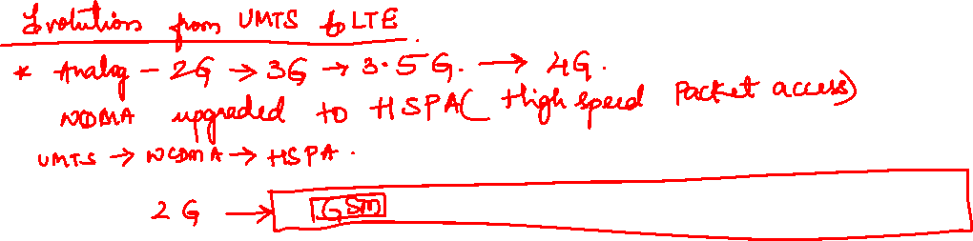
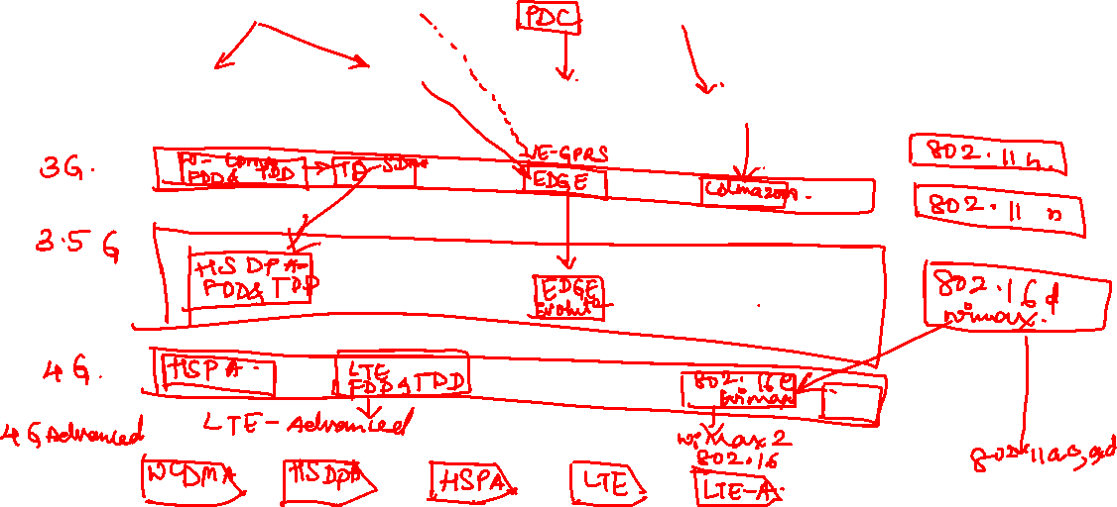


Slide 3

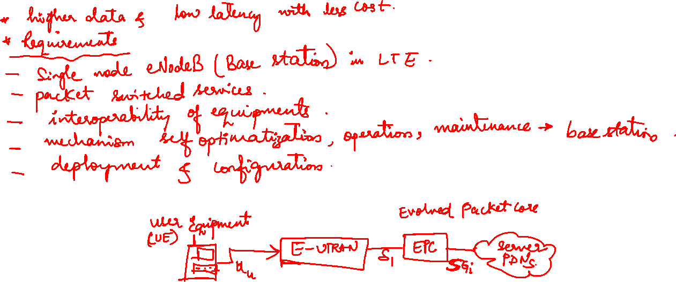

Slide 4
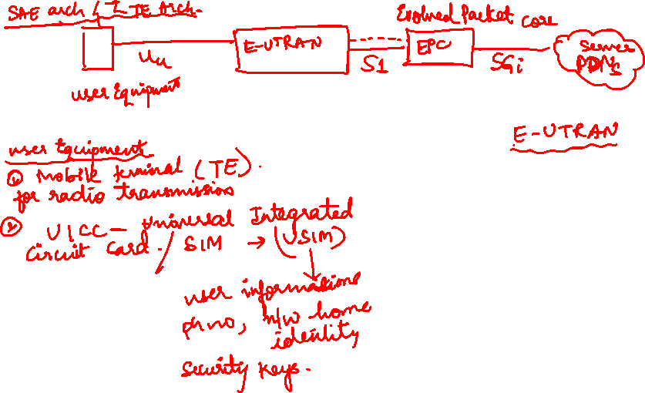
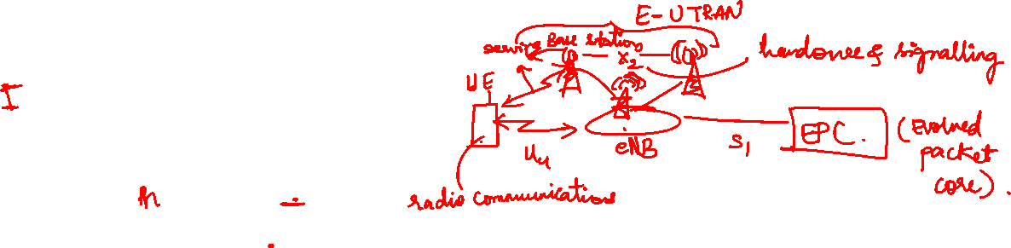

Slide 5
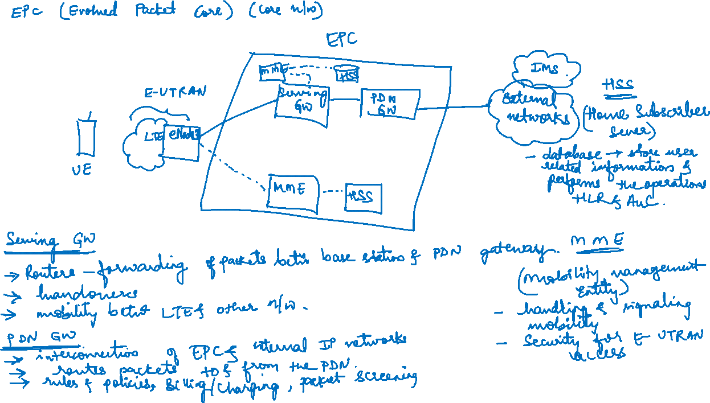

Slide 6
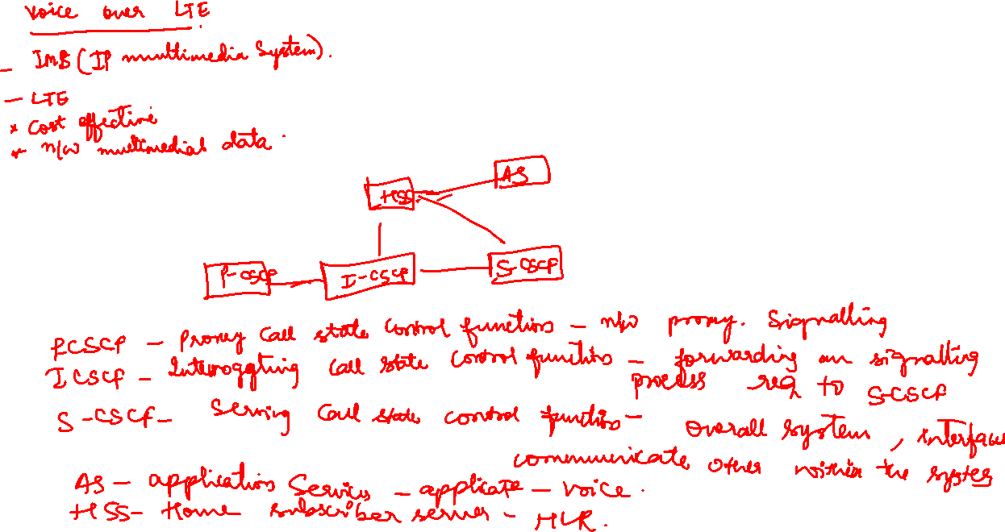

Slide 7
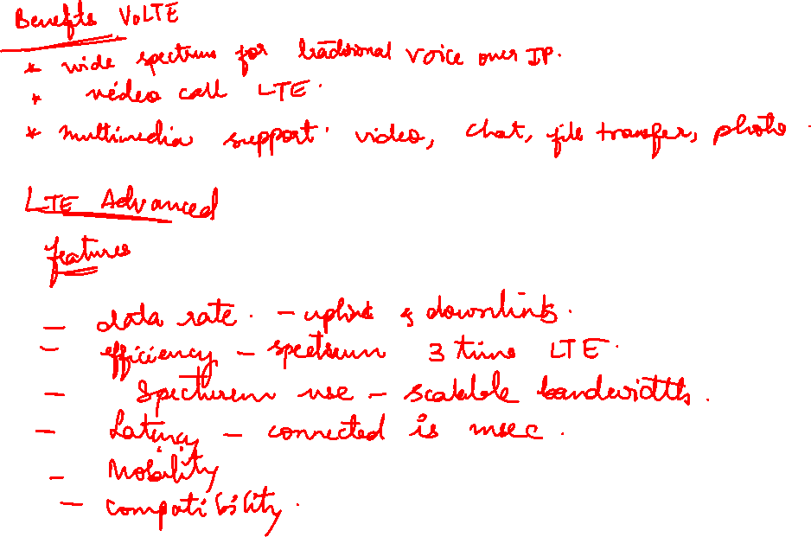

Slide 8
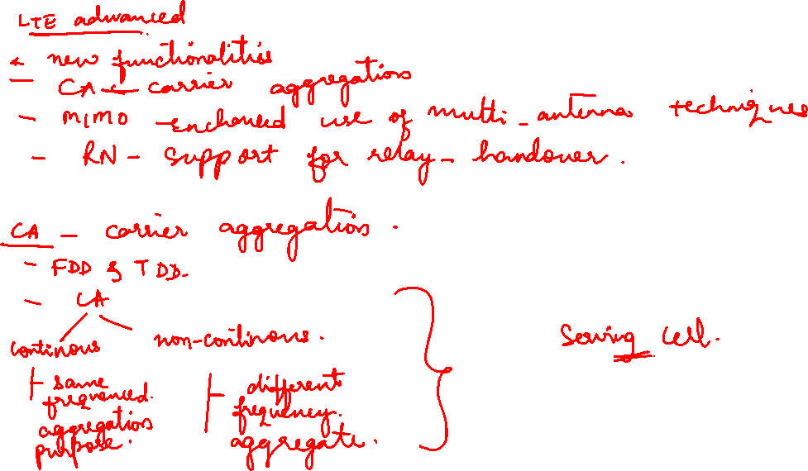

Slide 9
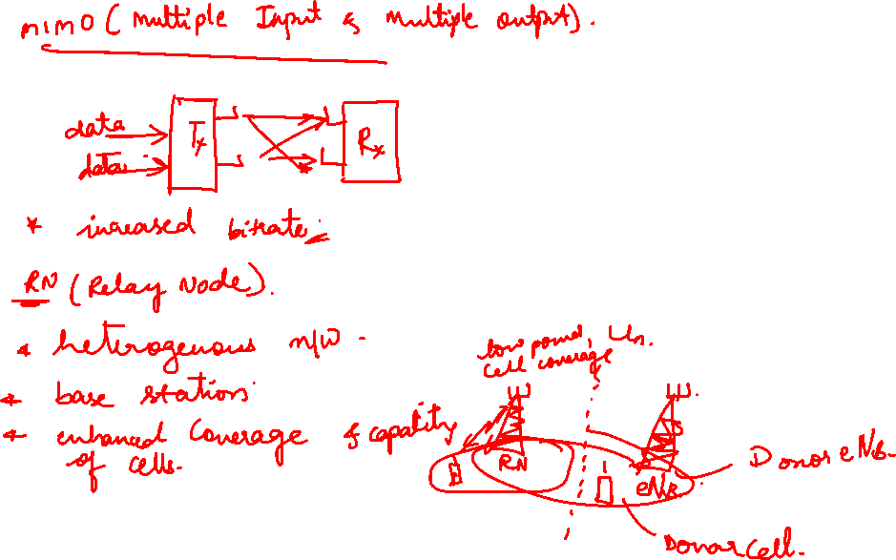

Slide 10
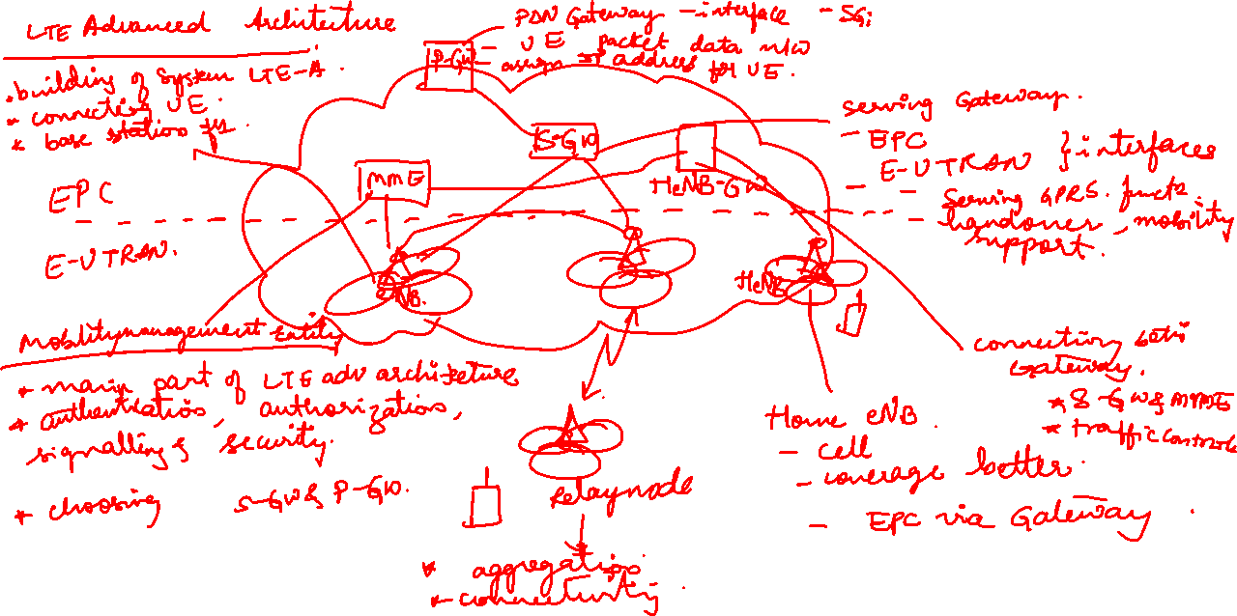

Slide 11
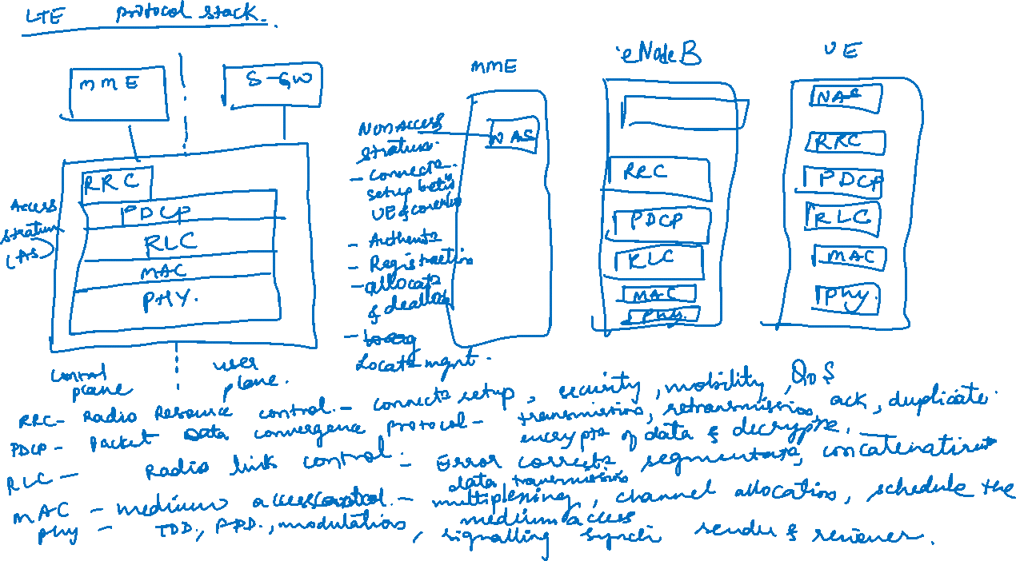

Slide 12
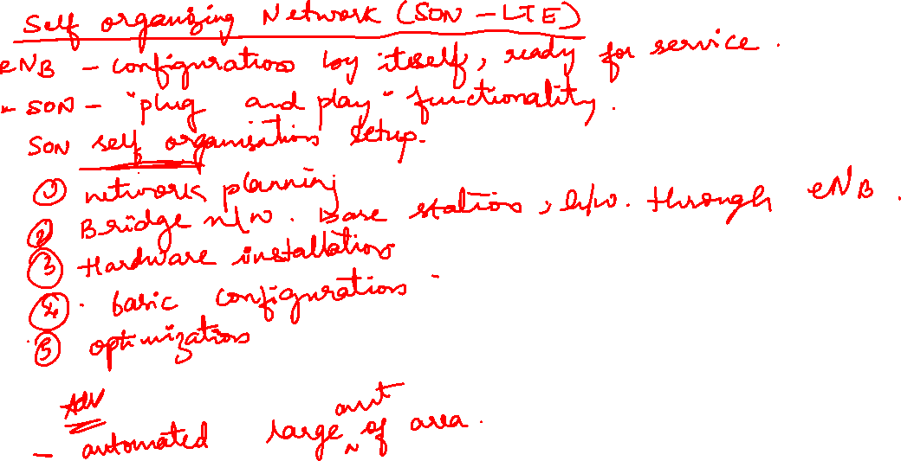

Slide 13
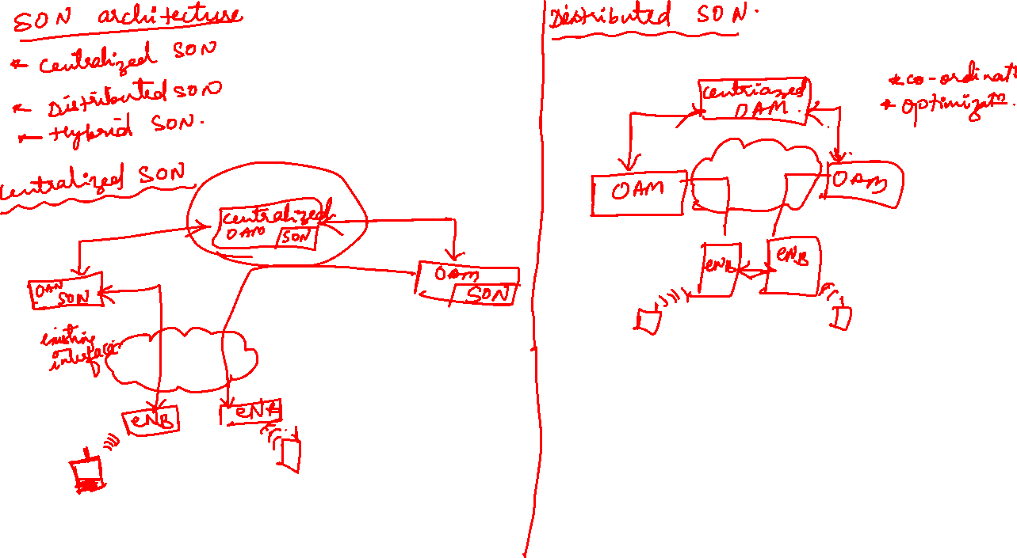

Slide 14
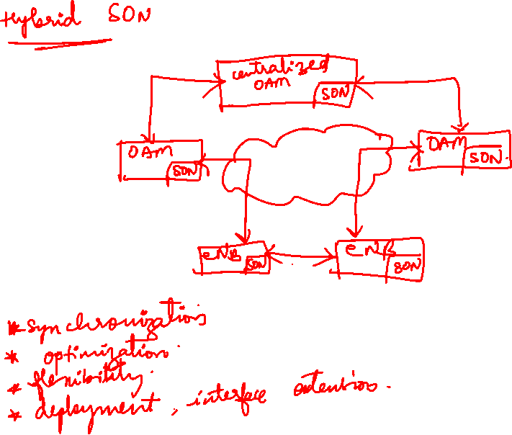

Slide 15
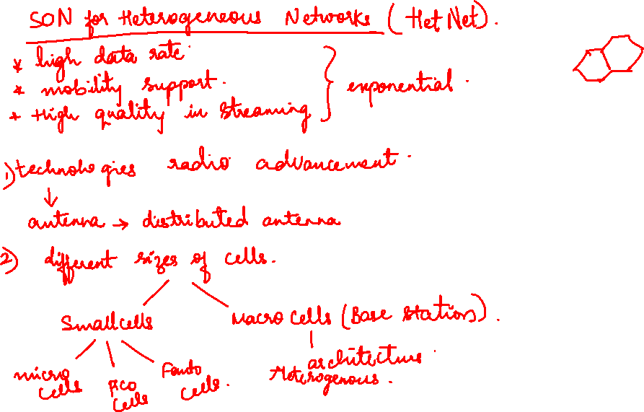

Slide 16
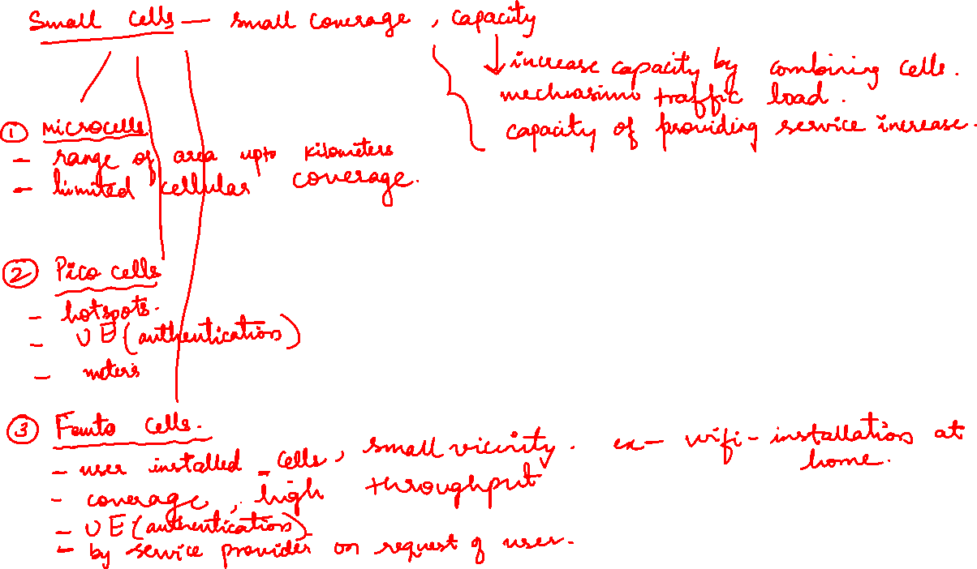

Slide 17
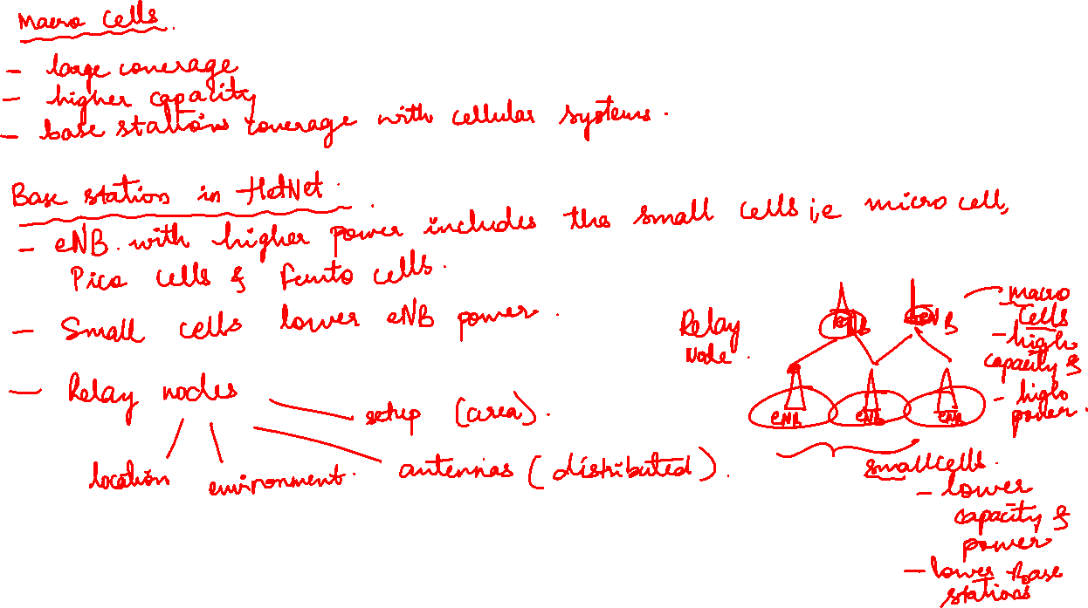

Slide 18
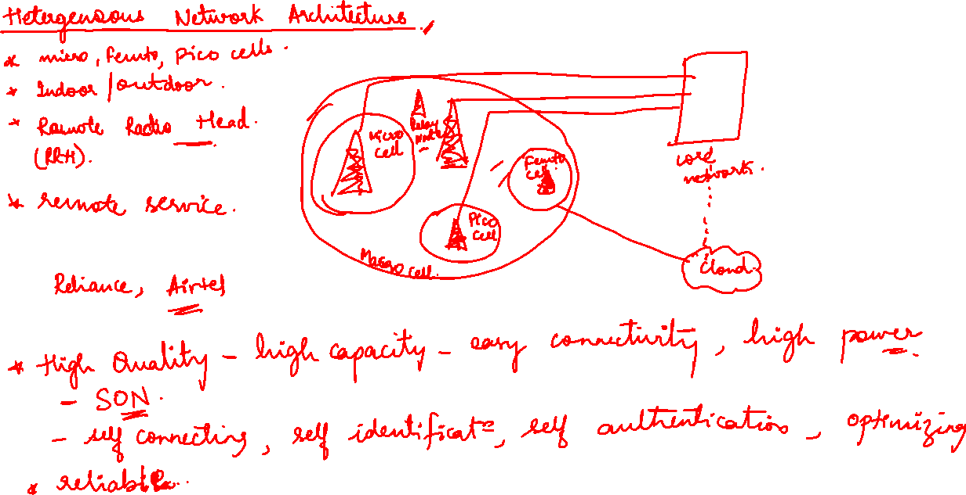

Slide 19
WLAN threats
Twin Aps
DOS
Passive capturing
Configuration Problems
Misbehaving

Slide 20
Securing Wireless Networks
Firewalls
Restrict Access
Encrypt data on your network
Antivirus
Connect using VPN

Slide 21
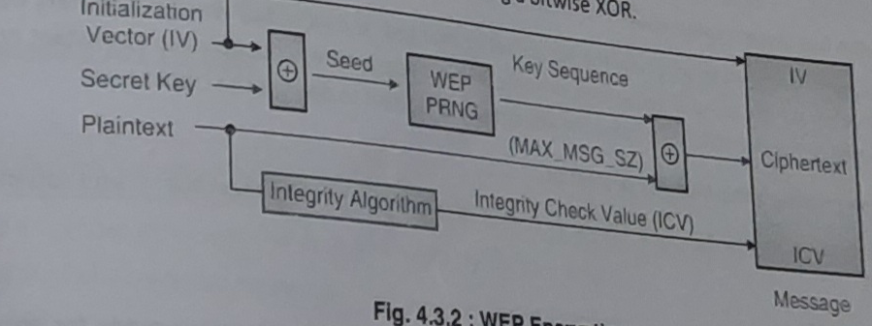
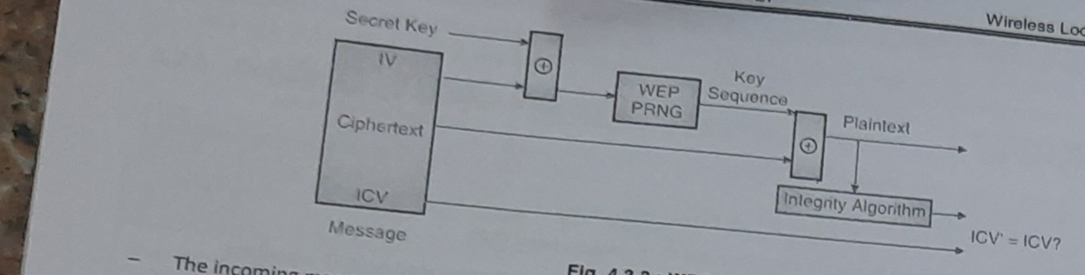
Wi-fi security standards
WEP(Wired Equivalent Privacy)
WEP Authentication---Challenge Response
WEP Encryption WEP Decryption

Slide 22
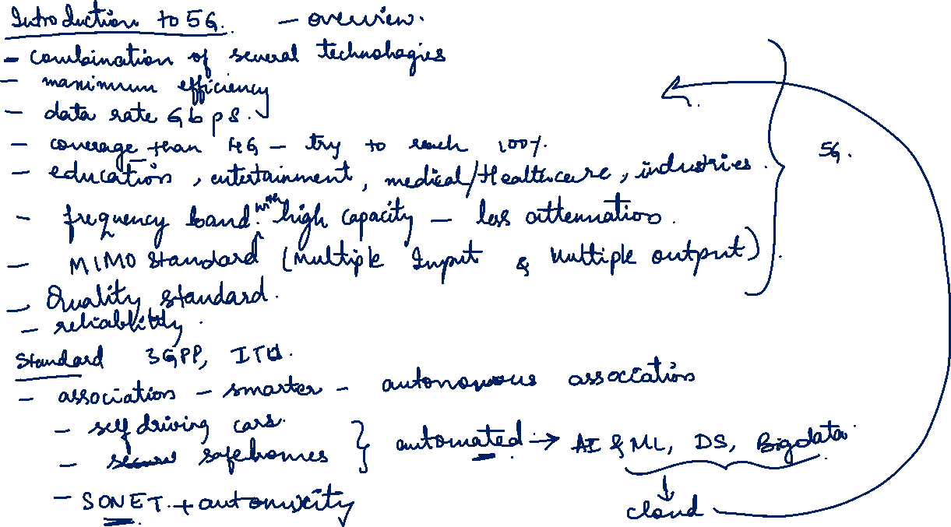

Slide 23
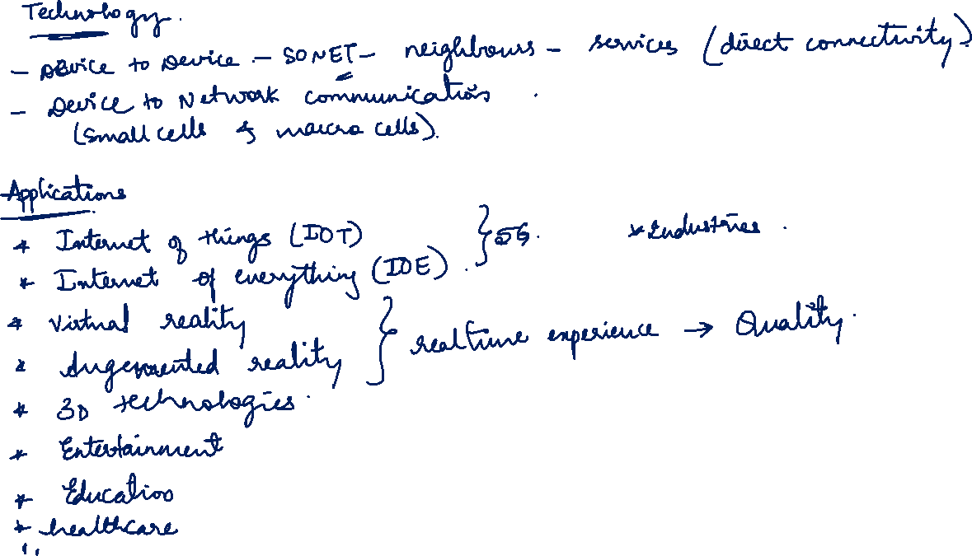

Slide 24
1G, 2G, 3G, 4G, and 5G are different generations of mobile communication technologies. Each generation represents significant advancements in terms of network capabilities and features.
Here are the key differences between 1G, 2G, 3G, 4G, and 5G technology:
1G (First Generation):
Introduced in the 1980s, 1G technology was the first commercially available mobile communication system.
It used analog signals for voice transmission.
Data transfer rates were very low, typically limited to 2.4 kbps.
1G systems had limited coverage and capacity and were primarily used for voice calls.

Slide 25
2G (Second Generation):
2G technology emerged in the early 1990s, introducing digital cellular networks.
It used digital signals and introduced various digital modulation techniques like GSM (Global System for Mobile Communications) and CDMA (Code Division Multiple Access).
2G networks provided improved voice quality and offered additional services like text messaging (SMS).
Data transfer rates increased to around 64 kbps, enabling basic internet access and email.
3. 3G (Third Generation):
3G technology was introduced in the early 2000s, offering faster data rates and improved multimedia capabilities.
It supported higher data transfer rates, ranging from hundreds of kilobits per second (kbps) to several megabits per second (Mbps).
3G networks enabled video calling, mobile internet access, and multimedia streaming.
The introduction of 3G laid the foundation for the widespread use of smartphones and mobile data services.

Slide 26
4G (Fourth Generation):
4G technology emerged around 2010, providing significant improvements over 3G networks.
It offered even faster data rates, ranging from tens of Mbps to hundreds of Mbps.
4G networks introduced technologies like LTE (Long-Term Evolution) and WiMAX, enabling high-speed internet access, video streaming, and online gaming.
4G networks provided lower latency and improved network capacity, supporting more concurrent users and better overall performance.
5. 5G (Fifth Generation):
5G technology started rolling out in the 2010s, offering revolutionary advancements in speed, latency, capacity, and connectivity.
It provides extremely high data transfer rates, potentially reaching several gigabits per second (Gbps).
5G networks have significantly lower latency, enabling real-time communication and supporting emerging technologies like autonomous vehicles, remote surgery, and Internet of Things (IoT) applications.
5G networks offer massive connectivity, allowing a large number of devices to be connected simultaneously with high reliability and efficiency.

Slide 27
Applications of 5G
The fifth generation of wireless technology—5G—represents the changing face of connectivity. Designed for maximum speed and capacity, 5G has the potential to vastly expand how data is moved and will enable a wide range of new applications and use cases that go far beyond the smartphone.
While broad 5G rollouts are expected by 2021, engineers are already hard at work on applications and devices that will make use of the benefits of 5G. From the evolution of the IoT to revolutionary advances in how AI is used in the real world, many of tomorrow’s most exciting technological advances will depend on 5G connectivity.
Harnessing the Power of IoT
When the term “Internet of Things” was coined in 1999, it was largely conceptual. Two decades later, everything from home thermostats to smart city sensors depend on IoT technology. Now, 5G and IoT stand ready to enable applications that would have seemed impossible just a few years ago.
5G’s promise of low latency and high network capacity helps to eliminate the biggest limitations to IoT expansion. Giving devices nearly real-time ability to sense and respond, 5G and IoT are a natural pairing that will impact nearly every industry and consumer.

Slide 28
Broadband-Like Mobile Service
Upgraded mobile service is among the most noticeable of the initial impacts of the 5G network rollout. All major US wireless carriers, as well as many smaller communications service providers, intend to deploy 5G mobile networks that will deliver broadband-like services, such as high-definition streaming video without dreaded buffering. With a vastly increased network capacity, 5G is also predicted to reduce slowdowns during usage spikes—for example, sports fans can still stream during the big game.
Connectivity for Edge Computing
With the move to cloud-native 5G networks, enterprises can take advantage of strategically distributed computational power, allowing more data to be processed and stored in the right place based on the needs of the application. Intelligent edge computing operates at the convergence of 5G’s ultra-low latency, IoT, and AI technologies. Devices and applications can tap into edge cloud computing resources without needing to access a centralized data center potentially thousands of miles away.
As 5G edge computing becomes more pervasive, industries will be able to dramatically scale up their use of data and act on insights faster—often instantly and autonomously.

Slide 29
Unleashing AI
Applying AI to an immense amount of data at scale will be accelerated with fast, efficient connectivity. For example, smart city AI could correlate traffic light data automatically and implement new patterns after an apartment complex nearby is opened. Smart security and machine vision can keep secure facilities safe with automatic recognition of potential security breaches or unauthorized visitors.
While 5G will help enable AI inference at the edge, it will also play a role in delivering data from devices to the central cloud to train or refine AI models. For example, real-world data about road conditions collected by connected vehicles can improve cloud-based mapping services.
Immersive Gaming and Virtual Reality
For gamers, 5G promises a more immersive future. High-definition live streaming will get a big boost from 5G speeds, and thanks to ultra-low latency, 5G gaming won’t be tied down to devices with high computing power. Processing, storage, and retrieval can be done in the cloud, while the game itself is displayed and controlled by a mobile device.
Low-latency 5G will drive major innovation in virtual reality (VR) applications, which depend on fast feedback and response times to provide a realistic experience. These applications are likely to explode in number and sophistication as 5G networks and devices become the new normal.

Slide 30
Industry Applications
Whether their goal is to increase revenue opportunities, reduce total cost of ownership (TCO), or improve customer experiences, today’s enterprises are expected to see major benefits from the 5G upgrade.
Healthcare
5G healthcare use cases will enable doctors and patients to stay more connected than ever. Wearable devices could alert healthcare providers when a patient is experiencing symptoms—like an internal defibrillator that automatically alerts a team of ER cardiologists to be ready for an incoming patient, with a complete record of data collected by the device.
Retail
For 5G retail applications, the customer experience will be everything. Stores of tomorrow may no longer look like today’s aisles of stocked shelves. Imagine a store that’s more like a showroom—one that lets you add items to a virtual cart rather than shopping with a physical one.
Stores may also use 5G to manage inventory and stocking in real time. Consumers could even see changes like cashierless stores that simply track what you put in your cart in lieu of the traditional checkout line.

Slide 31
Agriculture
Farms of the future will use more data and fewer chemicals. Taking data from sensors located directly in fields, farmers can identify with pinpoint precision which areas need water, have a disease, or require pest management.
As wearables become less expensive and 5G makes it easier to scale networks containing large numbers of IoT devices, health monitoring for livestock may also emerge. With more accurate health data, farmers can reduce the use of antibiotics without compromising the safety of the food supply.
Manufacturing
Factory floors will be totally transformed by the convergence of 5G, AI, and IoT. Beyond predictive maintenance that helps control costs and minimize downtime, factories will also use 5G to control and analyze industrial processes with an unprecedented degree of precision.
With the connectivity boost provided by 5G, manufacturers can also change traditional quality assurance processes, streamlining them with sensor technology and AI.

Slide 32
Logistics
In shipping and logistics, keeping track of inventory is expensive, slow, and difficult. 5G offers the potential for greater communication among vehicles, as well as between vehicles and infrastructure itself.
Fleet monitoring and navigation will become significantly easier at scale with 5G. Driver navigation could potentially be powered with an augmented reality system that identifies and flags potential hazards without diverting a driver’s attention away from the road.

